Slide 2
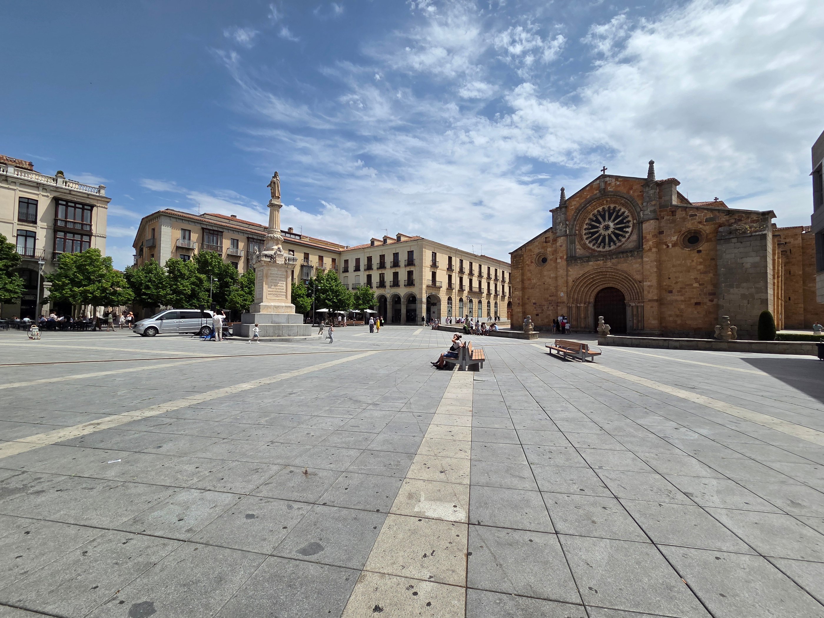

AVILA, SPAIN
Gospel Ministry & Church Strengthening
A Mission Partnership Opportunity for the Churches
and Members of the Chilhowee Baptist Association
Approved by the CBA Executive Board July 8, 2025

Slide 3

VISION
Every Church
Bringing all the Gospel
to Every Community

Slide 4
MISSION
cultivate powerful partnerships
that build healthy pastors
& strong churches to impact communities with the gospel

Slide 5
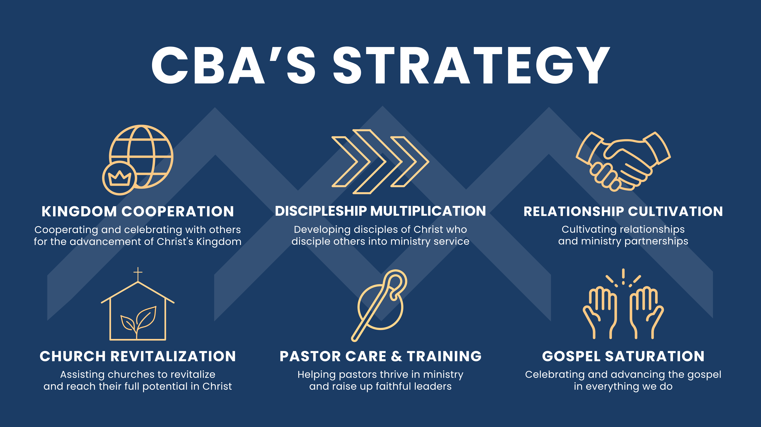

Slide 6

AVILA, SPAIN
Cooperative effort between
the Chilhowee Baptist Association,
Buen Pastor Church Madrid,
Buen Pastor Church Avila,
and the International Mission Board
field team in Spain
KINGDOM
COOPERATION
Cultivating Powerful Partnerships in Spain
Ministry Overview | Goals | Timeline | Funding | Mission Opportunities

Slide 7
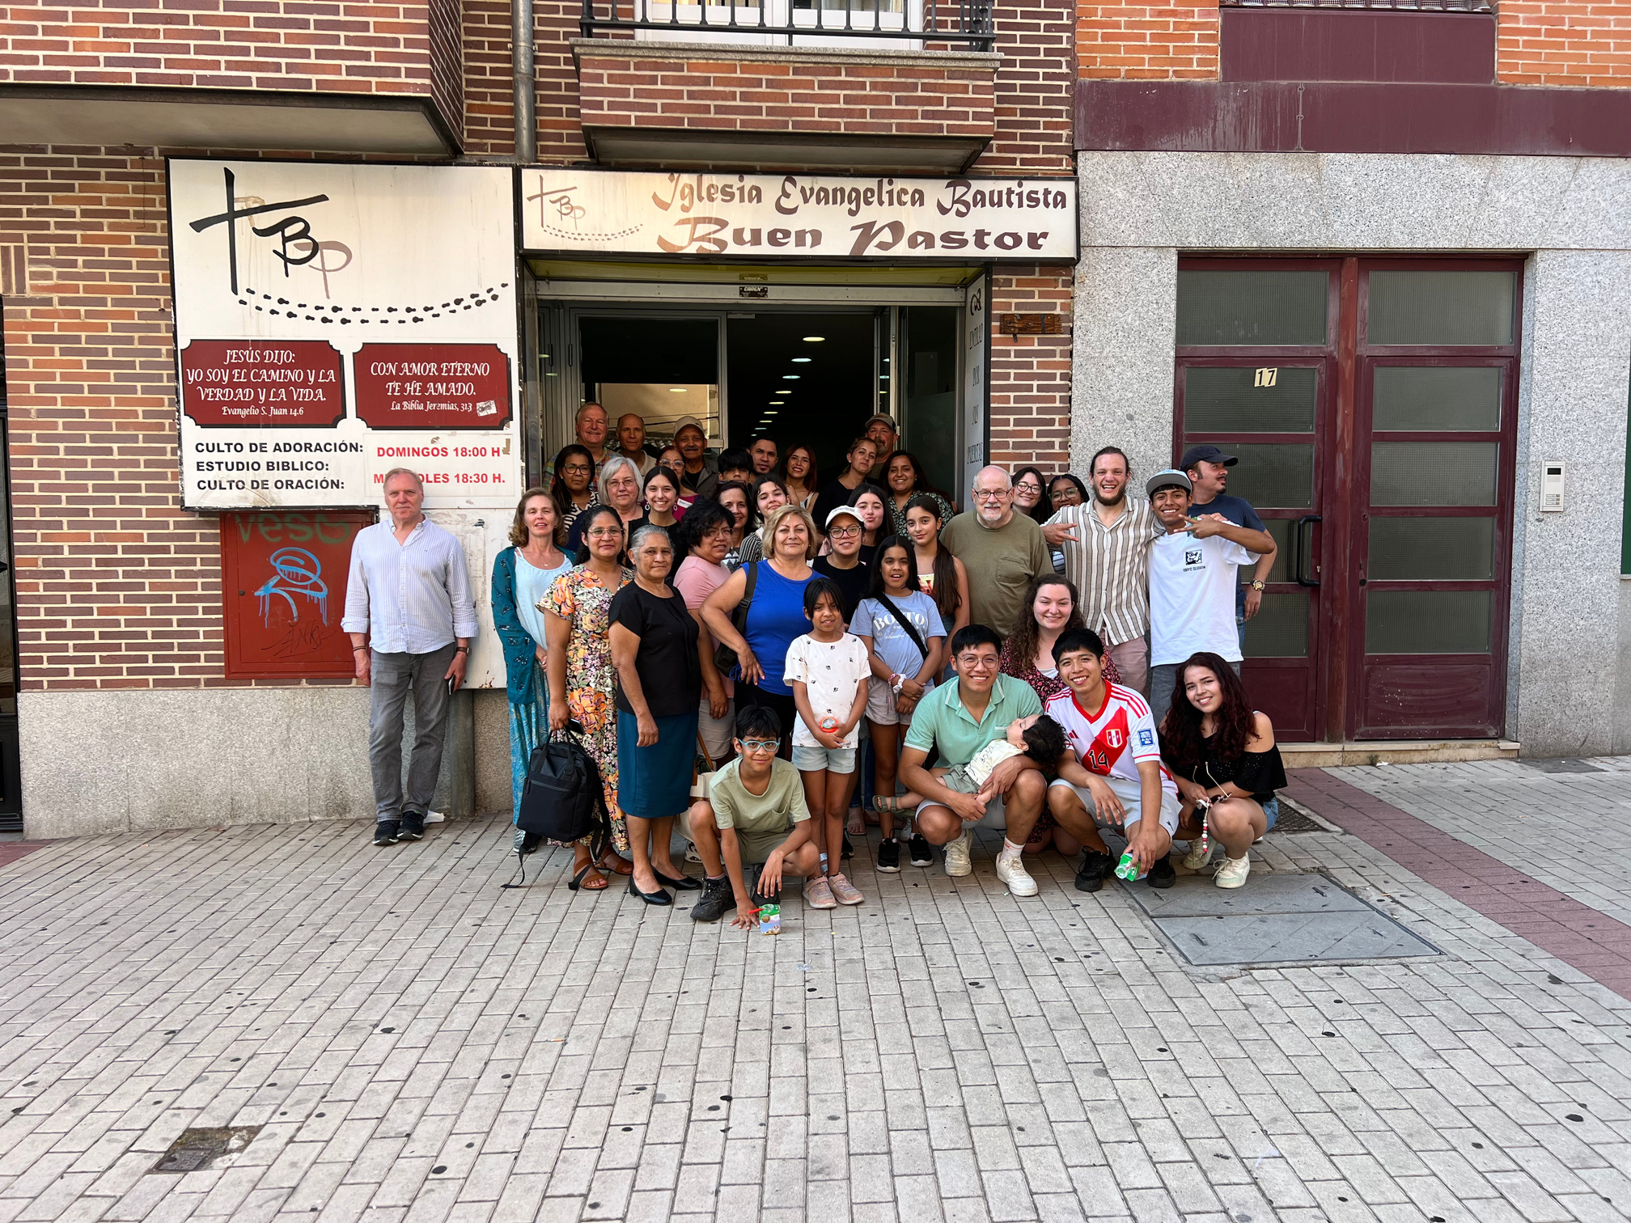
OVERVIEW
– 6 year old church plant
of Buen Pastor Church in Madrid
– CBA has recently sent teams
to work alongside the church plant,
returning in the coming years
– Buen Pastor Church in Madrid
is committed to their support
of the church plant over
the next several years
CBA Team with the congregation
of Iglesia Bautista Buen Pastor Avila

Slide 8
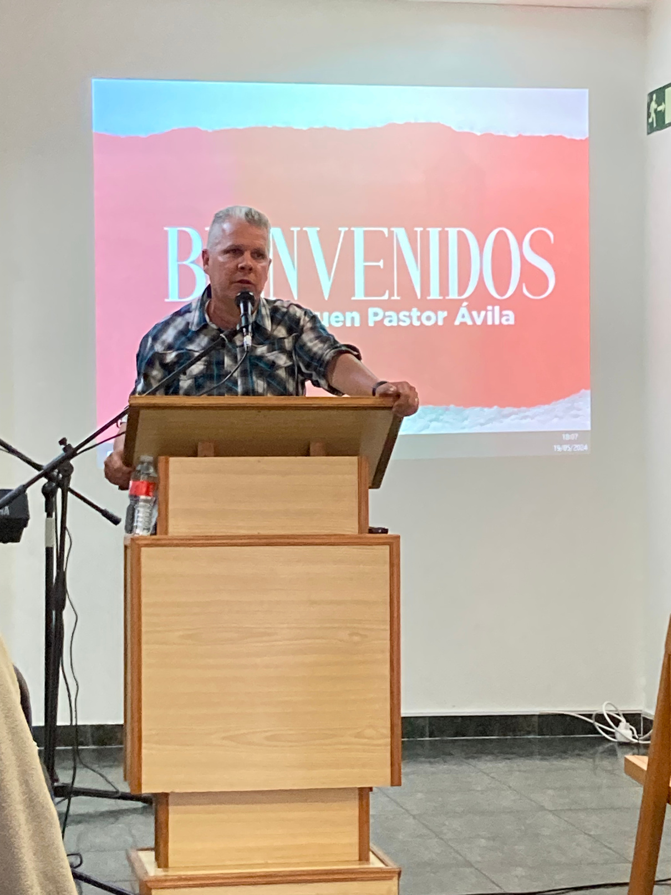
OVERVIEW
Pastor Giorge & His Family
– Migrated from Cuba several years ago
– Over 12 years of pastoral experience
– Recently confirmed his calling
as Pastor of the Avila church
– Actively taking steps to move to Avila
Pastor Giorge Sanchez

Slide 9

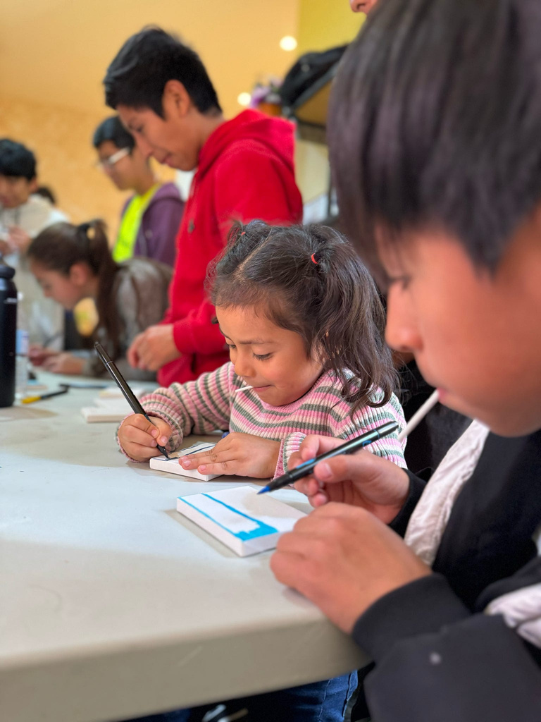
  GOALS
Funding
Sending
Establish funding for three years to support a full-time pastor for the Buen Pastor Church in Avila, Spain
Send mission support teams over the next
three years to the church plant in Avila
Prayer
Provide monthly prayer updates to support
the ongoing gospel work
in Avila

Slide 10



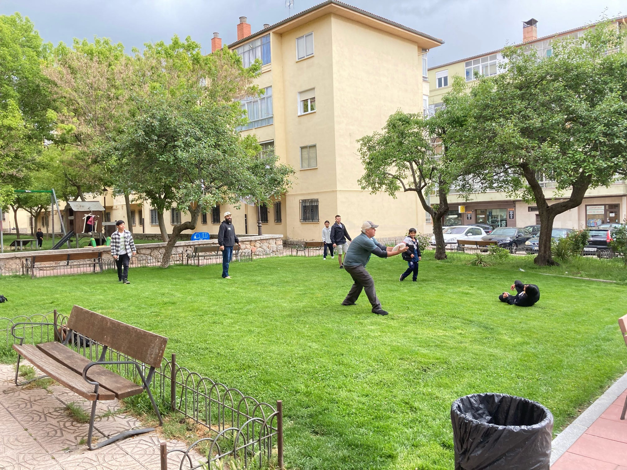


  MINISTRY PLANS
ESL (English as a
Second Language)
VBS (Vacation
Bible School)
Sports
Clinics
outreach & relationship development
biblical understanding
& family discipleship
evangelism & relationship development
Discipleship
Leadership Development
spiritual growth
for all ages
pastoral development
& leadership pipeline

Slide 11
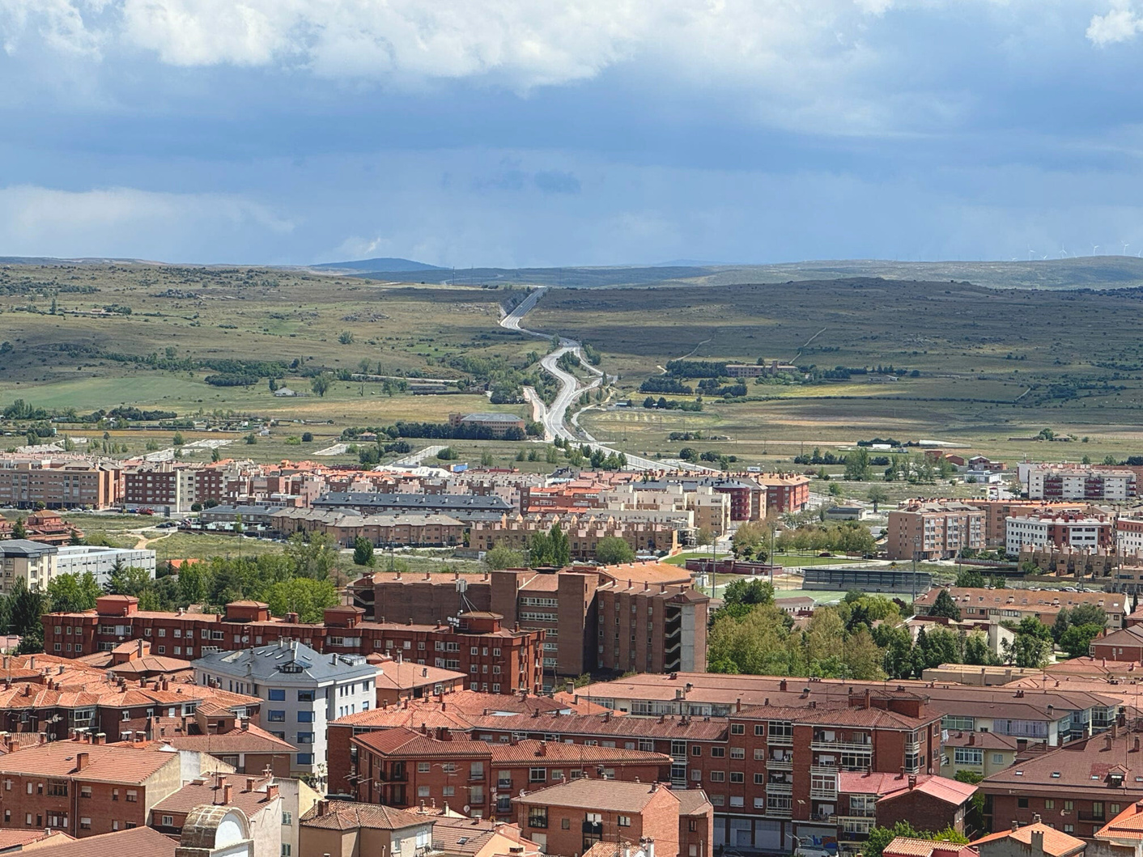

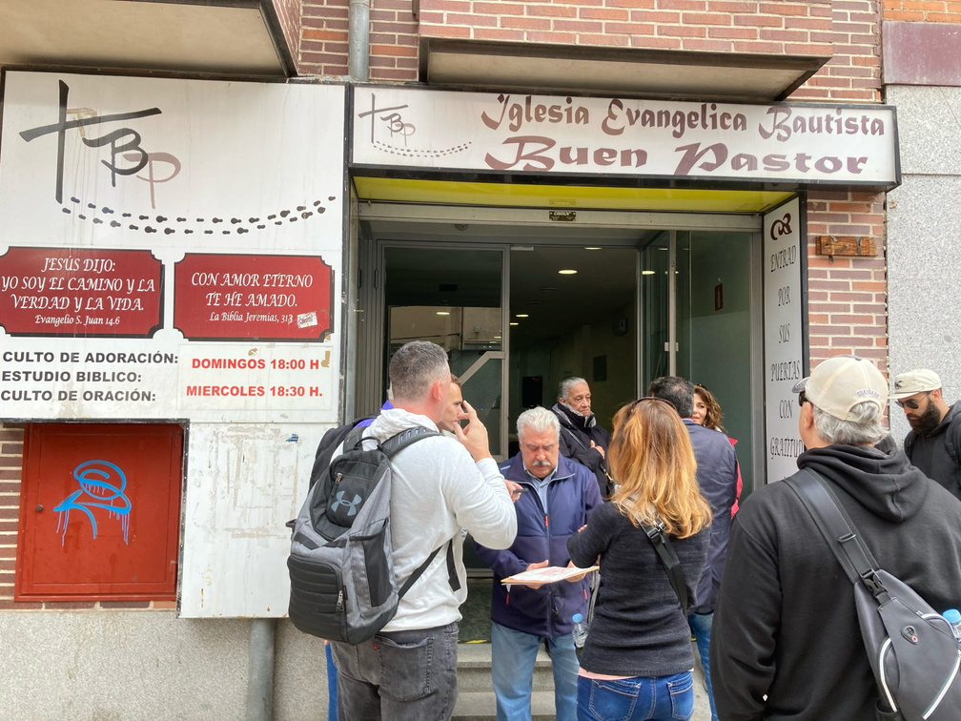
  TIMELINE
August 2025
Aug - Dec 2025
Partnership
Support
Begin partnership with first
6 months of support ($12,000)
Secure monthly funding commitments
from churches, groups, & individuals
Summer 2026
Sending
Send teams to support
the Avila Church (sports, ESL, VBS)

Slide 12
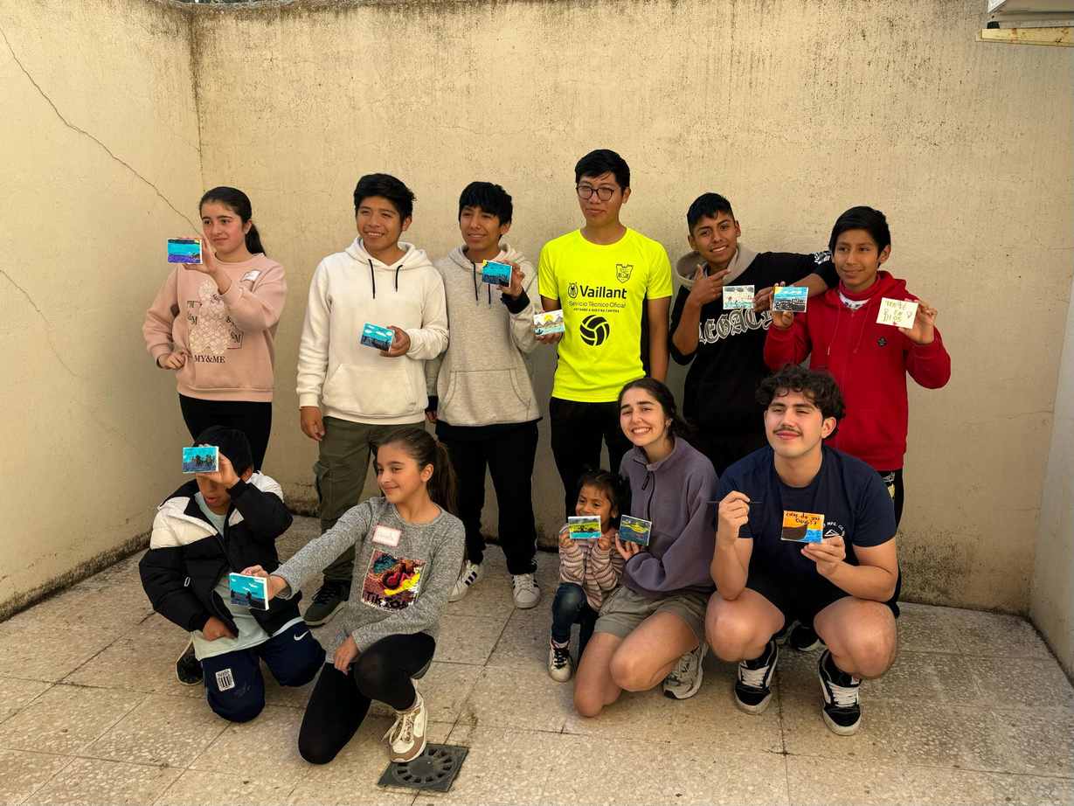
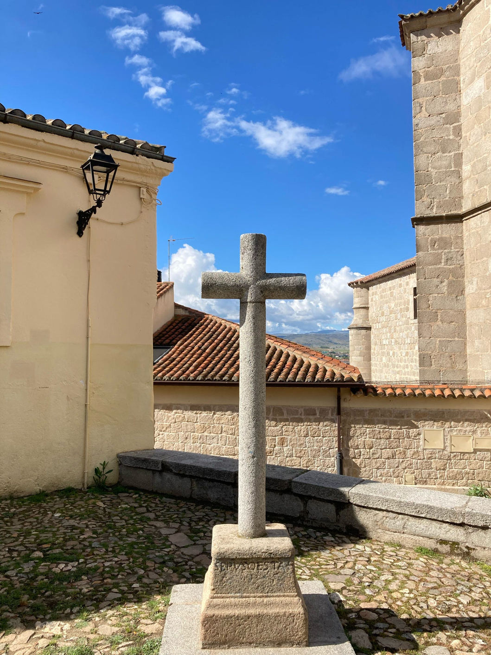
  TIMELINE
Summer 2027
Sending
Send teams to support the Avila Church (sports, ESL, VBS)
Summer 2028
Sending & Evaluate
Send teams to support the Avila Church (sports, ESL, VBS)
Evaluate church ministry status & discuss
possible partnership extension

Slide 13
  FUNDING
Annual Funding Pledged from Buen Pastor Church in Madrid
Annual Funding Pledged from Buen Pastor Church in Avila
$ 21,000
$ 7,200
(approx. US dollars)
(approx. US dollars)
Buen Pastor Madrid
will provide utility expense
and rent for Buen Pastor Avila
Buen Pastor Avila will provide ministry expenses and
pastor salary supplement

Slide 14

  FUNDING
Annual Funding Pledged
from CBA through 2028
Pastor Salary
& Housing
$ 24,000
Church
Building Rent
(approx. US dollars)
Ministry
Expense
Church
Utilities
Chilhowee Baptists will provide for the pastor’s housing, utilities, and salary supplement

Slide 15
COMMITMENT LEVELS
32 = Churches / Individuals
$200
$100
$24,000 = Annual Amount
Pledged by CBA to Buen
Pastor Avila (3 Years)
Two Churches @ $200/Month for three years
($2,400 Annually)
Three Churches @ $100/Month for three years
($1,200 Annually)
$300
$50
$25
One Church @ $300/Month for three years
($3,600 Annually)
Six Churches @ $50/Month
for three years
($600 Annually)
Seven Churches @ $25/Month for three years
($300 Annually)
$75
$10
$10
Five Churches @ $75/Month for three years
($900 Annually)
Eight Churches @ $10/Month for three years
($120 Annually)
Seven Individuals @ $10/Month for three years
($120 Annually)

Slide 16
MINISTRY OPPORTUNITIES
ESL Camps
Sports Camps
Leadership
Development
ESL (English as a Second Language) is a popular
& effective outreach tool
Sports camps are popular
& draw younger generations
Leadership training & development for the church in Avila
Vacation
Bible School
Is God calling your church to Spain?
Vacation Bible School draws children & families from outside the church

Slide 17
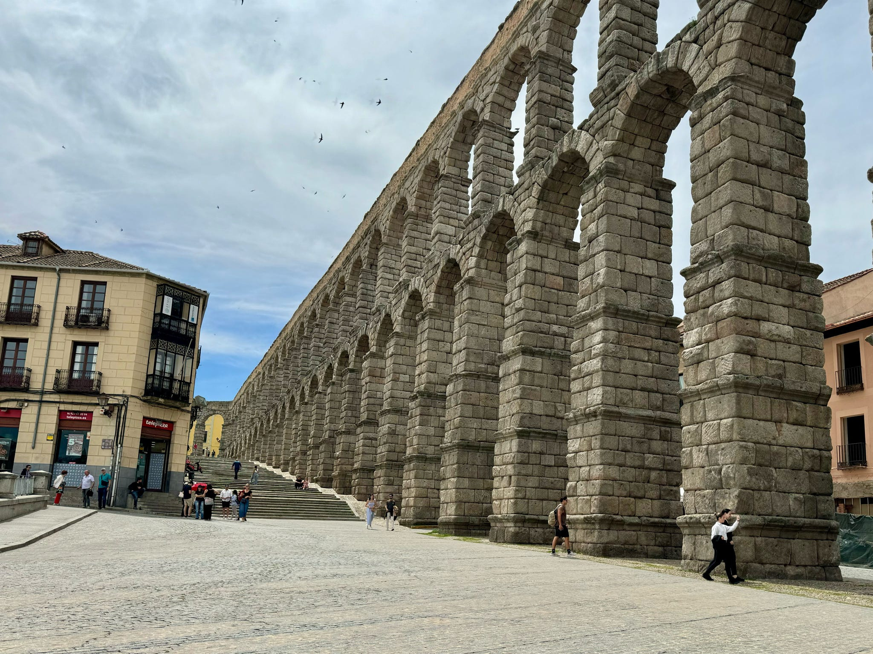
TRIP INFORMATION
Estimated Cost: $2,700 (8-9 day trip)
AIRFARE | Direct flight options from Charlotte, NC
LODGING (AVILA) | Hotel | 2-3 Bed Rooms (0.7 miles from the church)
LODGING (MADRID) | Apartment-style Lodging | Metro is 1 block away
TRANSPORTATION | Walking in country | Reliable Metro Train System

Slide 18






Connect
Chilhowee Baptist Association
Jim Snyder
865-604-2276
jimsnyder@cbalive.org
IMB Field Personnel
Steve Marlin
stevemarlin@hotmail.com
www.cbalive.org

Slide 19



COMMITMENT FORM
Seek the Lord and his desires for your church.
God may lead you to partner with his work in Spain,
whether through giving, going, praying, or sending.
www.cbalive.org

